Slide 1

Department of Materials and Optoelectronic Science, National Sun Yat-Sen University (NSYSU)
Antimicrobial Effects of Thin Film Metallic Glasses Deposited on 316L Stainless Steel
Student: Sunny Chu
Advisor: Prof. J. C. Huang
Date: 2012/11/13

Slide 2
Outline
Part 1 - Antimicrobial activity
Introduction
Motivation
Experimental procedures
Preliminary results
Part 2 - Biocompatibility
Introduction
Motivation
Experimental procedures
Preliminary results
Future work

Slide 3
Antimicrobial methods
1. Mechanisms of antimicrobial activity :
Silver, Copper, Quaternary ammonium, Antimicrobial peptides
2. Selectivity:
Bactericides, Viral inhibitors, Fungal inhibitors
3. Surface modification:
Surface roughness, Superhydrophobic surfaces,
Coatings (Self-cleaning coatings and Antimicrobial additives)
http://en.wikipedia.org en.wikipedia
Notes:
蛋白質的3D的結構可以被改變，銅，從而使蛋白質可不再執行其正常功能。其結果是細菌或病毒的失活。銅配合物形成自由基，滅活病毒。銅可以與脂類相互作用，從而導致他們的過氧化和在細胞膜上的開口孔，從而影響細胞的完整性，這可能會導致洩漏的必要的溶質

Slide 4
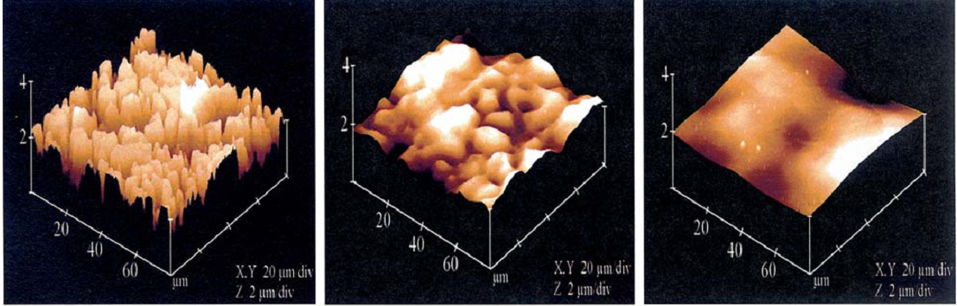
AFM observation
316 stainless steel surfaces
As-received
Electropolished for 1.5 min at room temperature
Electropolished for 5 min at room temperature
M. Haidopoulos et al., J. Mater. Sci. Mater. Med., 17, 647-657 (2006)
Notes:
電化學拋光過程，旨在除去任何脆弱的中間層，包括原生氧化層和碳污染層，為了獲得平滑的，無缺陷的表面，以優化的粘附性

Slide 5
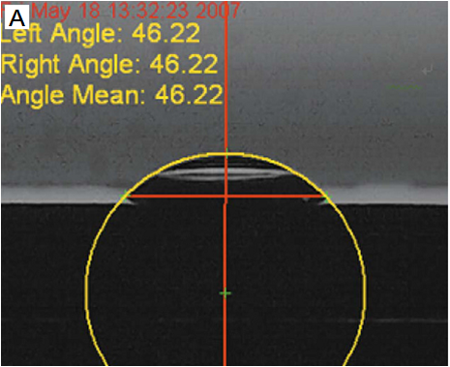
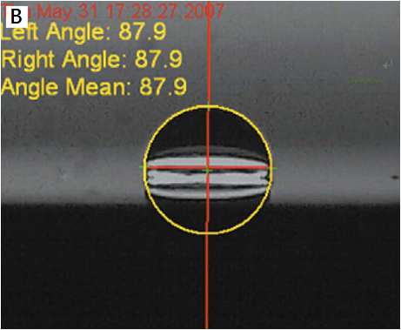
Water contact angle test
The flat surface was thought to improve its hydrophobic ability.
304 stainless steel substrate
surface roughness: 7.5 nm
Zr₆₁Al_{7.5}Ni₁₀Cu_{17.5}Si₄ TFMG coating
surface roughness: 1 nm
Chiang et al., Fooyin J Health Sci., 2, 12 (2010)

Slide 6
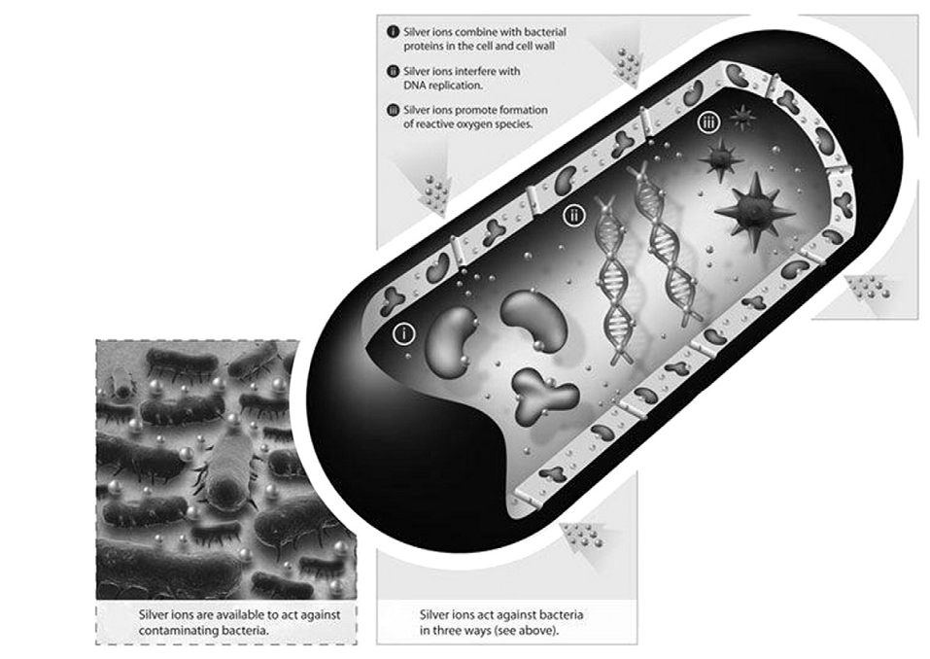
Antimicrobial activity
Previous reports have shown antimicrobial effects of materials with silver ions kill bacteria by destroying cell walls and membranes.
Devasconcellos et al., Mater. Sci. Eng. C, 32, 1112-1120 (2012)
Notes:
銀離子會破壞細胞壁和膜，和DNA結合使DNA失去複製能力，銀離子產生自由基氧，抑制細胞呼吸作用

Slide 7
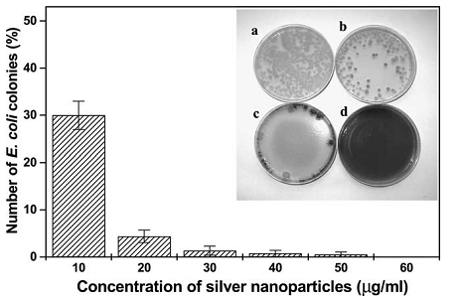
Antimicrobial activity
Silver nanoparticles were shown to be an effective bactericide on E. coli.
Containing different concentrations of silver nanoparticles:
(a) 0 (b) 10 (c) 20 (d) 50 µg cm⁻³
I. Sondi and B. Salopek-Sondi, J. Colloid Interface Sci., 275, 177-182 (2004)
Notes:
large surface area，attack the respiratory chain（呼吸鏈），silver nanoparticles release silver ions in the bacterial cells

Slide 8
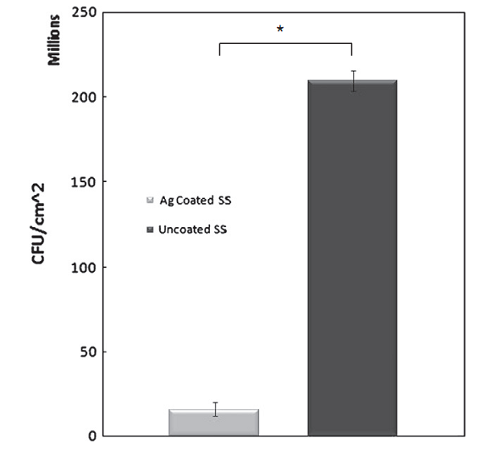
Antimicrobial activity
Particulate silver coatings on stainless steel implants for fracture management were shown to be an effective bactericide on Pseudomonas aeruginosa.
Devasconcellos et al., Mater. Sci. Eng. C, 32, 1112-1120 (2012)

Slide 9
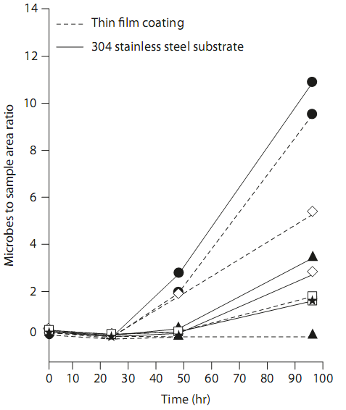
Antimicrobial activity
The surface of Zr₆₁Al_{7.5}Ni₁₀Cu_{17.5}Si₄ thin film metallic glasses (TFMGs) can exhibit the antimicrobial ability on bacteria.
Escherichia coli (▲)
Staphylococcus aureus (□)
Pseudomonas aeruginosa (● )
Acinetobacter baumannii (◇ )
Candida albicans (★)
Chiang et al., Fooyin J Health Sci., 2, 12 (2010)

Slide 10
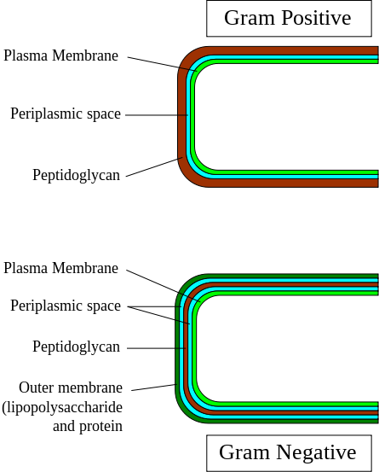
Gram positive and gram negative
http://en.wikipedia.org en.wikipedia
Notes:
金黃色葡萄球菌是positive, 大腸桿菌是Negative染成深藍或紫色的細菌.革蘭氏陰性菌所擁有的第二層膜和脂多糖層

Slide 11
Motivation
To achieve good antimicrobial effects, the surface conditions of stainless steel can be improved by thin film coating.
Copper and silver ions were described as good antibacterial agents but copper is cytotoxic. Therefore, the materials with silver compositions can be utilized for the instruments in heath care.

Slide 12
Flow chart
316L stainless steel
Glass
Mechanical polished
Electropolished
AFM
Sputtering
AFM
SEM
EDS
α-step
XRD
Contact angle
Nanoindenter
Biological assay
MTT assay
Antimicrobial test
SEM

Slide 13
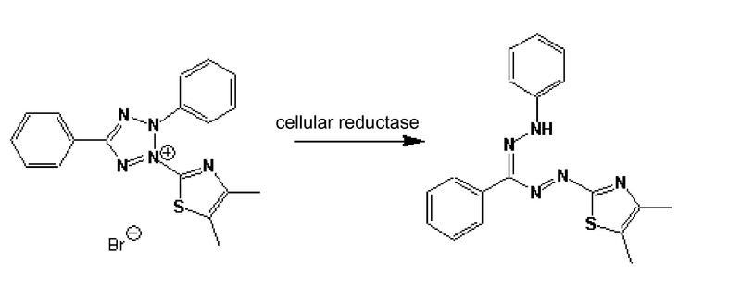
MTT assay
Formazan
(3-(4,5-Dimethylthiazol-2-yl)-2,5-diphenyltetrazolium bromide
http://en.wikipedia.org/wiki/MTT_assay
Notes:
其主要依賴活細胞內粒線體中的琥珀酸去氫脢之作用將MTT之tetrazolium轉為藍色之產物MTT formazan，堆積於細胞中，當加入DMSO將其溶解，則可利用測OD值得知細胞還原MTT的能力 (formazan形成量) ，此OD值代表了粒線體的活性

Slide 14
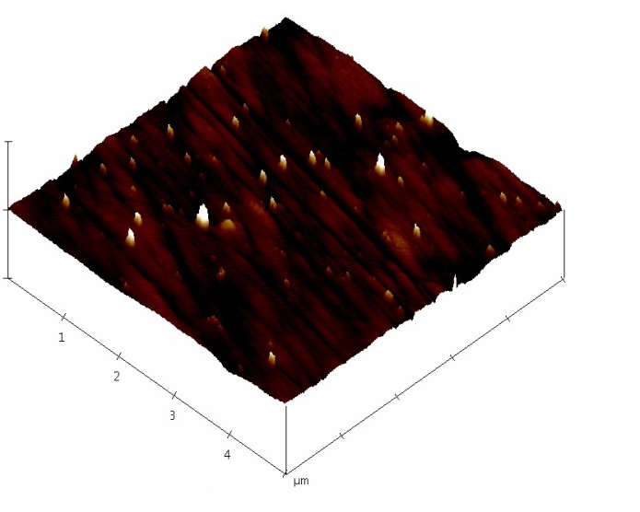
AFM observation
Substrate: 316L stainless steel
Surface treatment: grinded by #2000 sandpaper
Roughness (R_{ms}): 2.4 nm

Slide 15
AFM observation
Substrate: 316L stainless steel
Surface treatment: grinded by #4000 sandpaper
Roughness (R_{ms}): 2.3 nm

Slide 16
AFM observation
Substrate: 316L stainless steel
Surface treatment: 1. grinded by #180 sandpaper
2. electropolished (by MIRDC)
Roughness (R_{ms}): 1.5 nm

Slide 17
AFM observation
Substrate: 316L stainless steel
Surface treatment: 1. grinded by #600 sandpaper
2. electropolished (by MIRDC)
Roughness (R_{ms}): 1.1 nm

Slide 18
AFM observation
Substrate: 316L stainless steel
Surface treatment: 1. grinded by #1200 sandpaper
2. electropolished (by MIRDC)
Roughness (R_{ms}): 1 nm

Slide 19
Thin film preparation
Fabrication method:
Sputtering/co-sputtering processes
Substrates:
316L stainless steel
Glass substrate
Thin films:
Ag-based thin films

Slide 20
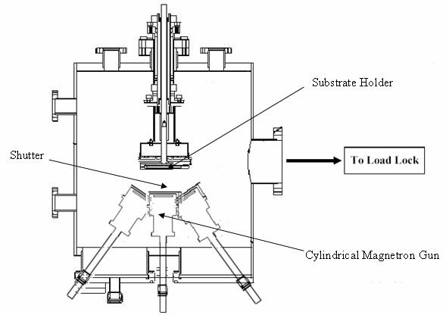
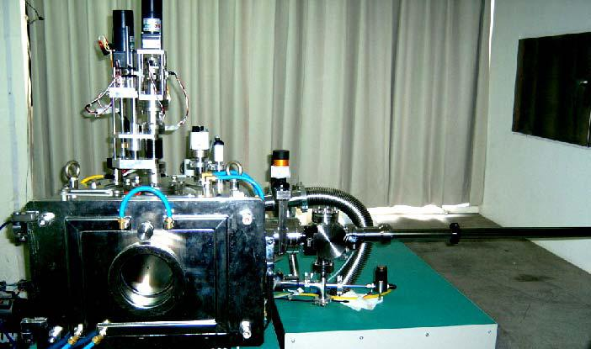
Sputtering process
Multi-gun sputtering system
Base pressure: 5 x 10⁻⁷ torr
Working gas: Ar, 30 standard cubic centimeters per minute (sccm)
Working pressure: ~3 x 10⁻³ torr
Rotational speed: 15 rpm

Slide 21
XRD identification
Notes:
Voltage of 40 kV and electron current of 30 mA. (2θ) was covered from 20º to 60º with a scanning rate of 0.1º per six seconds.

Slide 22
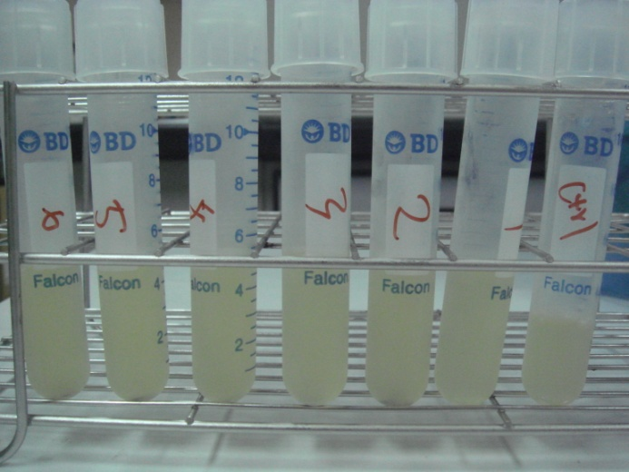
Antimicrobial test
Staphylococcus aureus
Sample | Thickness(nm) | Optical Density
Test time |  | 0 hr | 3 hr
Blank control |  | 52.7 | 64.9
Ag-based TFMG (1) |  | 53.5 | 65.4
Ag-based TFMG (2) | 1306 | 57.1 | 77.1
Ag-based TFMG (3) | 1972 | 56.9 | 82.6
Ag-based TFMG (4) | 1972 | 52.9 | 84.1
Antimicrobial test was conducted by KMUH.

Slide 23
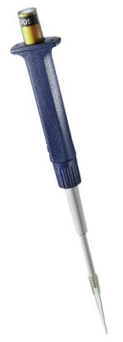

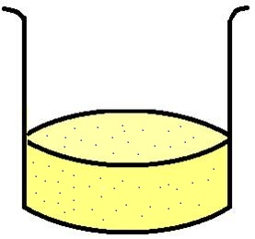
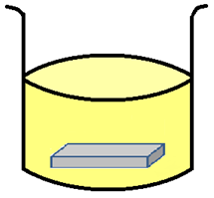
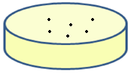
Antimicrobial test
Medium: Luria-Bertani (LB) broth
18 hours
24 hours
12hours
18hours
with bacteria
with sample
new medium
LB agar plate

Slide 24
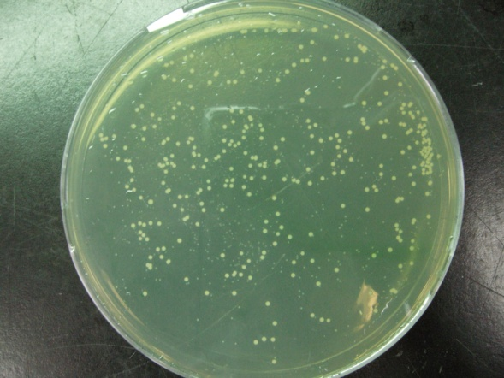
Antimicrobial test
Staphylococcus aureus
Sample | Thickness (nm) | Colony-forming unit / plate
blank control |  | 230
Ag-based TFMG (1) |  | 56
Ag-based TFMG (2) | 1306 | 80
Ag-based TFMG (3) | 1972 | 69
Ag-based TFMG (4) | 1972 | 49
Antimicrobial test was conducted by KMUH.

Slide 25
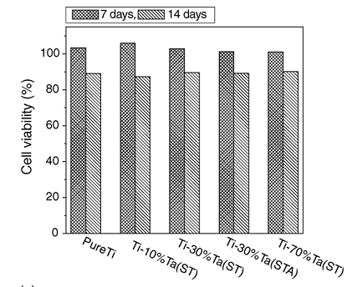
Biocompatibility
MTT assay
Zhou et al., Mater. Sci. Eng. A., 398, 28-36 (2005)

Slide 26
Motivation
Ti–Ta alloys exhibit good wear resistance, excellent corrosion resistance and biocompatibility. Hence, it is beneficial to enhance the surface conditions of stainless steel in biomedical implant by Ti-Ta thin films coating.

Slide 27
Flow chart
316L stainless steel
Glass
Mechanical polished
Electropolished
AFM
Sputtering
AFM
SEM
EDS
α-step
XRD
Contact angle
Nanoindenter
Biological assay
MTT assay
SEM
Notes:
scanning duration of each specimen was set at least 10 seconds per 500 mm.

Slide 28
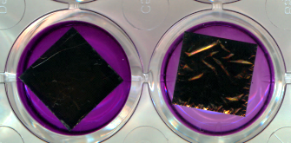
MTT assay
Conditions:
Cell: D1 bone marrow stem cell
Medium content: bone medium
Low glucose DMEM + 1.5 g sodium bicarbonate + 1% NEAA + 1% Vitamin C + 10% FBS + 1% P/S
Sample: TiTaSiZr TFMGs (about 1 cm × 1 cm) in 24 well
MTT assay: 24 hours
MTT assay was conducted by KMUH.

Slide 29
Thanks for your attention!

